Slide 1
Let’s Go Camping!

Slide 2
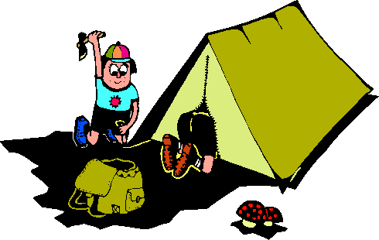
I went Camping with my father.

Slide 3
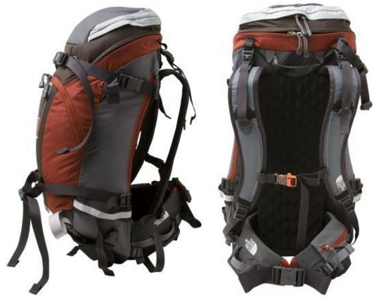
We Packed our bags.

Slide 4
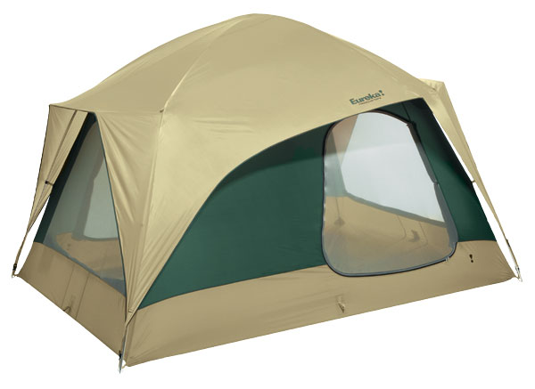
And slept in a Tent

Slide 5

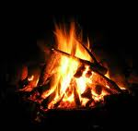

We built a fire and cooked hotdogs

Slide 6
It was lot of fun!

Slide 7
Camping!
Tent
Fire
Pack
Sleeping Bag
Hot Dogs

Slide 8
I am Going Camping
Time to pack
My tent, my sleeping bag
And a snack
I’ll sit by the fire
It’s burning bright
Then sleep in my tent
Until morning light

